Slide 1

Software Security and Privacy: A Brief Introduction
Dr. Mark Huasong Meng
Technical University of Munich
School of Computation, Information and Technology
Chair of Software Engineering & AI

Slide 2
Self-Introduction
Mark MENG, PhD
Post-doc researcher under the Chair of Software Engineering & AI at Heilbronn Campus
Education
B.Eng.(Hons), Computer Science, Nanyang Technological University
M.Comp., Infocomm Security, National University of Singapore
Ph.D., Computer Science, National University of Singapore
Work Experience
Been a software engineer/analyst in the cyber-security R&D industry since 2014

Slide 3
Today’s Agenda
Low-level memory-based security
Web security
Security analysis
Fuzzing and penetration testing

Slide 4
Low-Level Memory-Based Security
Memory in modern computer architecture · Memory & Stack · Buffer Overflow · Buffer-Overflow Vulnerability · Other Memory Attacks · Mitigations · Case Study

Slide 5
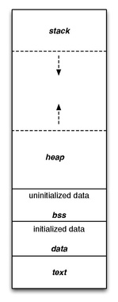
Low-level memory-based security
Memory in modern computer architecture
Four basic read-write memory regions in a program
Stack
Data
BSS (Block Started by Symbol), and
Heap
The data, BSS, and heap areas are collectively referred to as the “data segment”.

Slide 6
Low-level memory-based security
Memory in modern computer architecture
Stack
Stack is typically located in the higher parts of memory. It usually ”grows down”: from high address to low address. Stack is used whenever a function call is made.
Data Segment
Text segment: also known as a code segment or simply as text, is a portion of an object file or the corresponding section of the program‘s virtual address space that contains executable instructions. It is usually read-only.
Data area: contains global variables used by the program that are not initialized to zero. For instance the string “hello world” defined by char s[] = “hello world” in C would exist in the data part.

Slide 7
Low-level memory-based security
Memory in modern computer architecture
Data Segment (Continued)
BSS segment: starts at the end of the data segment and contains all global variables that are initialized to zero. For instance a variable declared static int i would be contained in the BSS segment.
Heap area: begins at the end of the BSS segment and grows to larger addresses from there. The Heap area is managed by malloc, realloc, and free. The Heap area is shared by all shared libraries and dynamic load modules in a process.
Which part(s) of the memory is safe/not safe?

Slide 8
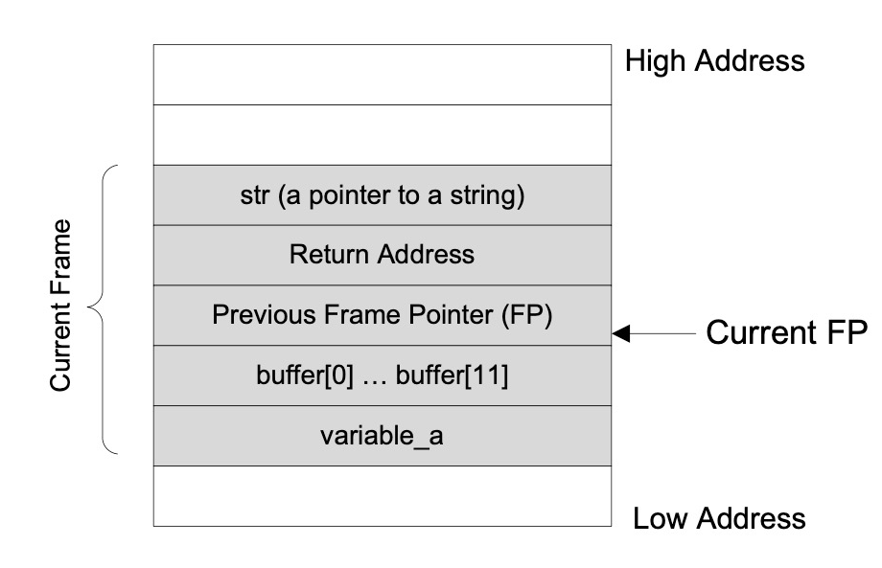
Low-level memory-based security
Memory & Stack
The stack layout after the execution has entered the function func()
void func (char *str) {
unsigned short a = 1979;
char buffer[8];
strcpy (buffer, str);
}
int main() {
char *str = “excessive”;
func(str);
}
variable a
buffer[0] … buffer[7]
Stack grows from high address to low address (variable defined earlier will be stored at higher address)

Slide 9
Low-level memory-based security
Memory & Stack
Return Address are address to be executed after the function returns.
Before entering a function, the program needs to remember where to return to after the execution of the function.
Frame Pointer (FP) is used to reference the local variables and the function parameters. This pointer is stored in a register.
variable a
buffer[0] … buffer[7]

Slide 10
Low-level memory-based security
Memory & Stack
Let’s have a look at the function again. Is this code memory safe?
void func (char *str) {
unsigned short a = 1979;
char buffer[8];
strcpy (buffer, str);
}
int main() {
char *str = “excessive”;
func(str);
}
variable a
buffer[0] … buffer[7]

Slide 11
Low-level memory-based security
Buffer Overflow
The function strcpy(buffer, str) copies the contents from str to buffer[].
The string pointed by str has more than 8 chars, while the size of buffer[] is only 8.
The function strcpy() does not check whether the boundary of buffer[] has been reached. It only stops when seeing the end-of-string character '\0’.
Contents in the memory above buffer[] will be overflowed, and other spaces will be overwritten by the characters at the end of str.
void func (char *str) {
unsigned short a = 1979;
char buffer[8];
strcpy (buffer, str);
}
int main() {
char *str = “excessive”;
func(str);
}

Slide 12
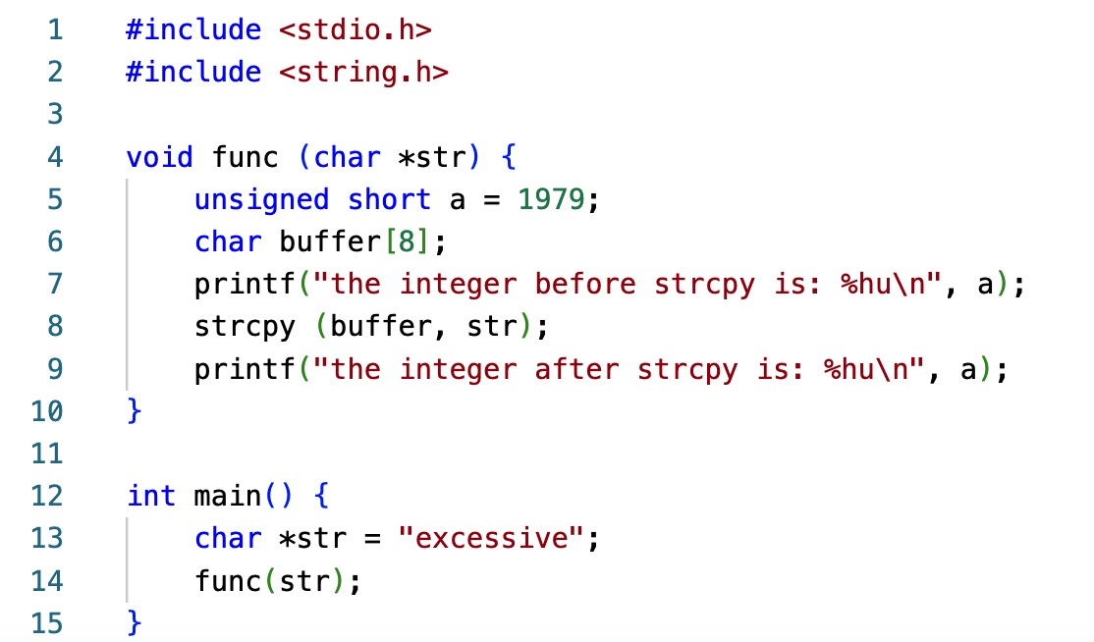
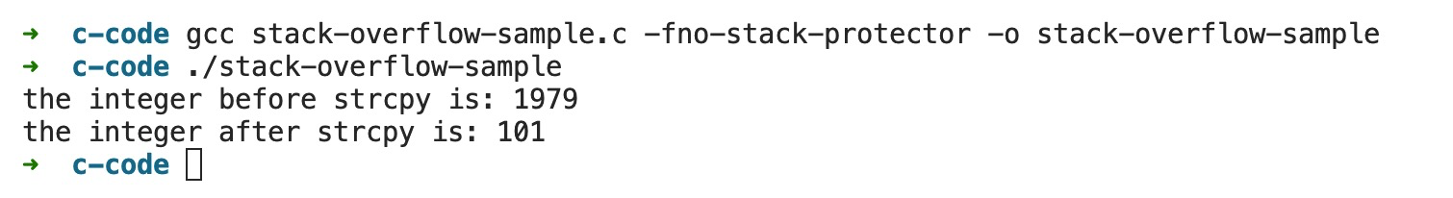
Low-level memory-based security
Buffer Overflow
Before the strcpy:
[null string] |  |  |  |  |  |  |  | 1979
00 | 00 | 00 | 00 | 00 | 00 | 00 | 00 | BB | 07
Because strcpy() does not check boundaries.
After the strcpy:
‘e’ | ‘x’ | ‘c’ | ‘e’ | ‘s’ | ‘s’ | ‘i’ | ‘v’ | ‘e’ | \0
65 | 78 | 63 | 65 | 73 | 73 | 69 | 76 | 65 | 00
The value of the variable a becomes 101 (converted from the Hex number 0065).
A little-endian scheme is assumed for the mainstream x86 architecture.

Slide 13
Low-level memory-based security
Buffer-Overflow Vulnerability
Three (challenging) steps to exploit a stack buffer-overflow vulnerability.
Injecting the malicious code: We need to be able to inject the malicious code into the memory of the target process. This can be done if we can control the contents of the buffer in the targeted program.
Jumping to the malicious code: With the malicious code already in the memory, if the targeted program can jump to the starting point of the malicious code, the attacker will be in control.
Writing malicious code (payload): The most powerful code is generally to invoke a shell, aka. shellcode, so that the attacker can run any command in that shell.
int func (char *str) {
char buffer[12];
strcpy(buffer, str);
return 1;
}
int main(int argc, char **argv) {
char str[517];
FILE *badfile;
badfile = fopen("badfile", "r");
fread(str, sizeof(char), 517, badfile);
func (str);
printf("Returned Properly\n");
return 1;
}

Slide 14
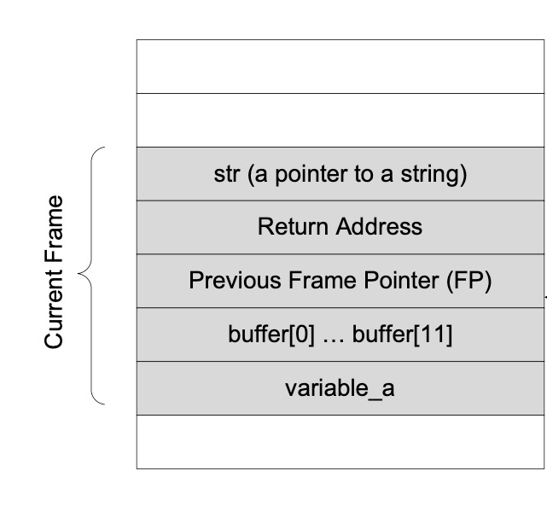
Low-level memory-based security
Buffer-Overflow Vulnerability
Injecting the malicious code
Jumping to the malicious code
Writing malicious code
High Address
High Address
Malicious Code (Payload)
Altered Return Address
variable a
variable a
buffer[0] … buffer[7]
Overflowed Buffer
Low Address
Low Address
(←) Memory during benign execution of a C function
(→) Memory after buffer-overflow attack

Slide 15
Low-level memory-based security
Other Memory Attacks
Heap Overflow
Unlike local variables and function arguments that are stored in the stack – global variables, constants, and references that use dynamically allocated memory are all stored in the Heap. An attacker can overflow the heap allocated by malloc.

Slide 16
Low-level memory-based security
Heap Overflow: An Example
#define BUFFER_SIZE 10
#define OVERFLOWED_SIZE 5
int main() {
unsigned long diff;
char *buf1 = (char *)malloc(BUFFER_SIZE);
char *buf2 = (char *)malloc(BUFFER_SIZE);
diff = (unsigned long)buf2 - (unsigned long)buf1;
printf("diff = %lu bytes\n", diff);
strcat(buf2, 'AAAAAAAAAA');
printf("buf2 before heap overflow = %s\n", buf2);
memset(buf1, 'B', (unsigned int)(diff+OVERFLOWED_SIZE));
printf("buf2 after heap overflow = %s\n", buf2);
...
}
~ ./heapoverflow.out
diff = 16 bytes
buf2 before heap overflow = AAAAAAAAAA
buf2 after heap overflow = BBBBBAAAAA
...
(←) Sample code of heap overflow attack (partial)
(↑) Console output of the sample code

Slide 17
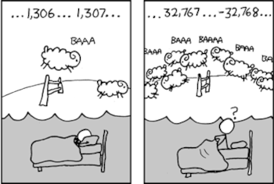
Low-level memory-based security
Other Memory Attacks
Integer Overflow
Occurs when an arithmetic operation on integers attempts to create a numeric value that is outside of the range that can be represented with a given number of digits – either higher than the maximum or lower than the minimum representable value.
Read Overflow (aka. Buffer Over-Read)
Rather than permitting writing past the end of a buffer (recall the strcpy code example), a bug could also permit reading past the end. Read overflow bugs might leak secret information.
Hint: 32768 is the largest allowed representation value of a 16-bit signed integer
The well-known Heartbleed bug (see next slide) and 2024 CrowdStrike IT outages are all caused by this type of bugs.

Slide 18

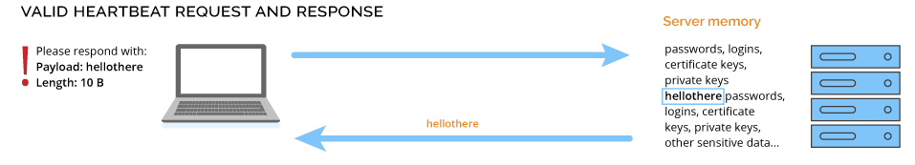
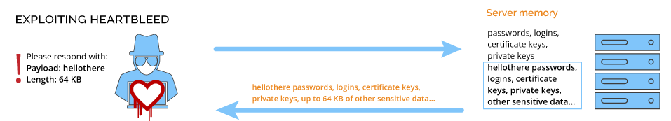
Low-level memory-based security
Case Study: Heartbleed Bug (CVE-2014-0160)
The Heartbleed Bug is a serious vulnerability in an extension named “Heartbeat” of the popular OpenSSL cryptographic software library.
This weakness allows stealing the information protected, under normal conditions, by the SSL/TLS encryption used to secure the Internet.
The information leaked may contain sensitive data, such as passwords, private keys, user’s personal information, etc.
(↑) Valid “Heartbeat” request and response
(↓) Exploiting Heartbleed bug

Slide 19

Low-level memory-based security
Mitigation
Apply Secure Engineering Principles
Use strong type (memory-safe) language, e.g., Java, C#, Python, etc
Use safe libraries (e.g., use fgets, strncpy, strncat, snptintf, rather than gets, strcpy, strcat, sptintf)
Systematic Code Modification
Separate control (i.e., return address) from data segments in memory
Mark the boundary of the buffer in the memory
Operating System Approach
Address space randomization
Non-executable stack in the memory
“The Canary”

Slide 20
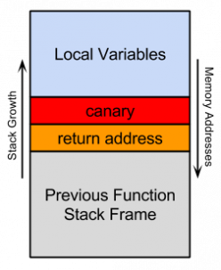
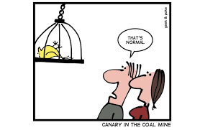
Low-level memory-based security
“The Canary”
Place a specific known value on the stack just prior to the return address. This known value is termed a “canary”.
An attempt to overwrite the return address will necessarily overwrite the canary.
If the canary has been altered, the program is halted.
A canary was used in coal mines to provide an advanced indication of a space of dangerous gasses

Slide 21
Low-level memory-based security
Summary
The idea behind the low-level memory-based attacks (e.g., buffer overflow attacks) is that the adversary is placing its own executable program, or exploit, in memory and making it execute.
“
“
Low-level memory-based attacks are where the software security story begins. It is the cornerstone of the entire cyber-security systemization of knowledge. Security analytics and hacking nowadays are still following the principles of low-level security.

Slide 22
Web Security
Web Basics · HTTP · SQL Injection · Session Hijacking · Cross-Site Request Forgery (CSRF) & Cross-Site Scripting (XSS) Attacks · Case Study

Slide 23
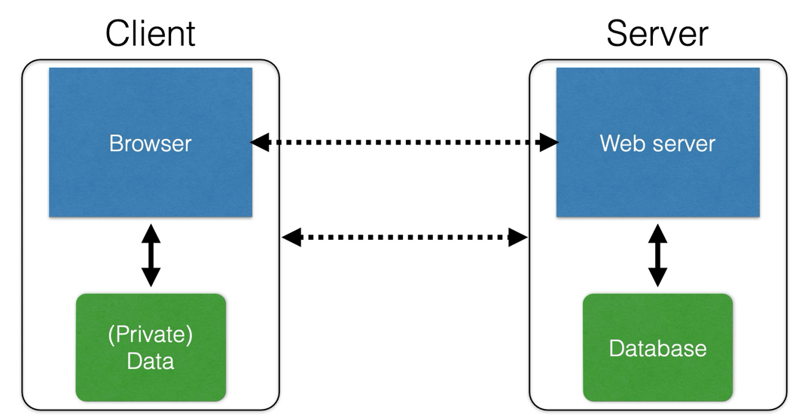
Web Security
Web Basics
User-owned data is stored locally and handled by the browser
The database is a separate entity and is physically located at the server side

Slide 24
Web Security
Web Basics
Interacting with web servers:
Resources which are identified by a URL (universal resource locator)
Path to resource arguments.
E.g., https://www.cs.umd.edu/~mwh/index.html
Protocol Hostname/Server Path to a resource
The file index.html is static content, i.e., a fixed file returned by the server upon request.
E.g., http://facebook.com/delete.php?f=joe123&w=16
Protocol Hostname/Server Path to a resource argument
Here, the file delete.php is dynamic content, i.e., the server generates the content on the fly upon request.

Slide 25
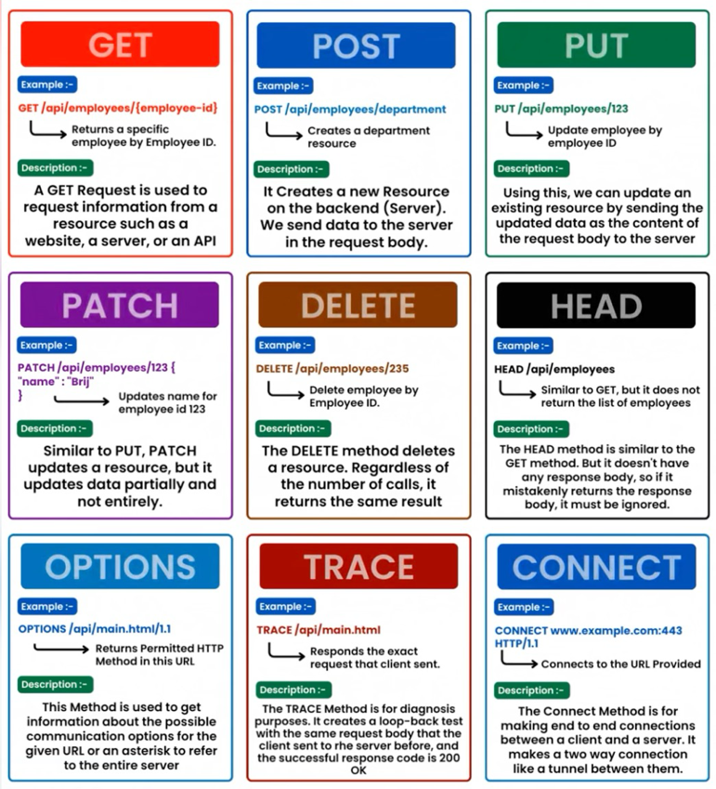
Web Security
Hyper-Text Transfer Protocol (HTTP)
The widest-used protocol of web traffic is HTTP
HTTP is An “application-layer” protocol for exchanging collections of data
There are some HTTP methods to construct our requests to the server.

Slide 26
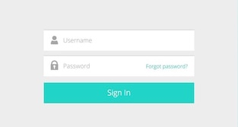
Web Security
SQL Injection
A toy example of SQL-based server-side code
The “Login code” (PHP) on the server side
$result = mysql_query(“select * from Users
where(name=‘$user’ and password=‘$pass’);”);
Suppose you have successfully logged in as $user and this request did receive returned results.
Is this method safe? How could you exploit this?

Slide 27
Web Security
SQL Injection
What if we manipulate the username input?
$result = mysql_query(“select * from Users
where(name=‘$user’ and password=‘$pass’);”);
$result = mysql_query(“select * from Users
where(name=‘frank’ OR 1=1); --and
password=‘$pass’);”);
frank’ OR 1-1); --

Slide 28
Web Security
SQL Injection
We can also chain together multiple statements with semicolons in between
$result = mysql_query(“select * from Users
where(name=‘$user’ and password=‘$pass’);”);
$result = mysql_query(“select * from Users
where(name=‘frank’ OR 1=1);
DROP TABLE Users; --and
password=‘$pass’);”);
frank’ OR 1-1); DROP TABLE Users; --

Slide 29

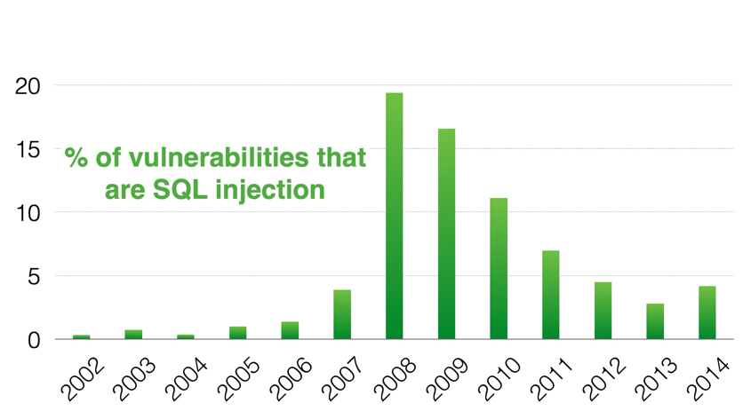
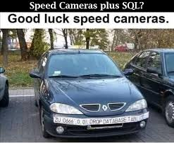
Web Security
SQL Injection
SQL injection attacks are common
https://xkcd.com/327/
http://web.nvd.nist.gov/view/vuln/statistics
A picture on Facebook

Slide 30
Web Security
Session Hijacking
An extremely common use of cookies is to track users who have already authenticated.
The server associates a “session cookie” with the logged-in user’s info.
Subsequent requests include the cookie in the request headers and/or as one of the fields: http://website.com/doStuff.html?sid=81asf98as8eak
The idea is to be able to say “I am talking to the same browser that authenticated Alice earlier.”

Slide 31
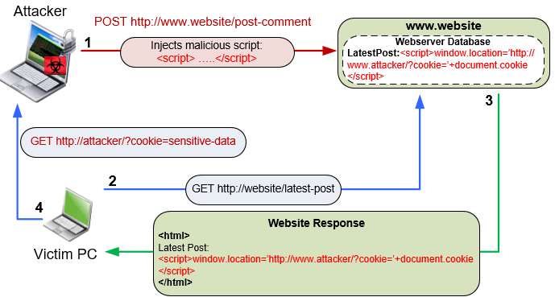
Web Security
Cross Site Scripting (XSS) Attacks
(→) An illustrative example of an XSS attack.

Slide 32

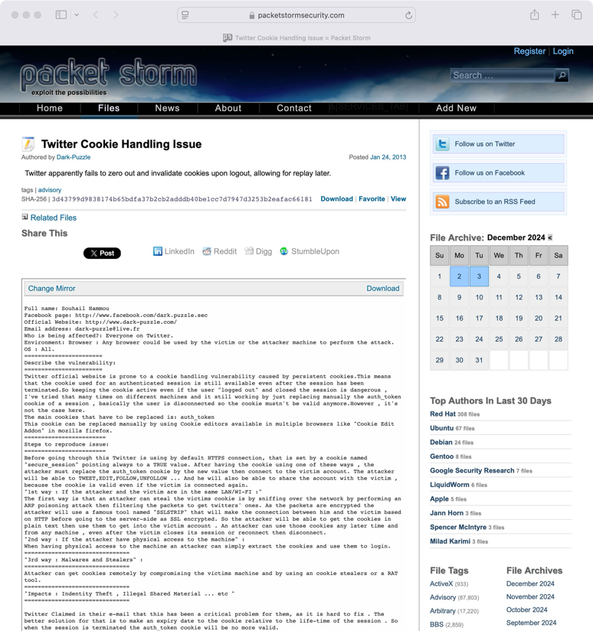
Web Security
Case Study: Twitter Cookie Handling Issue
Twitter uses one cookie (auth_token) to validate the user, which is a function of “username” and “password”.
Some weaknesses were found in auth_token in 2014:
The token does not change from one login to the next
The token does not become invalid when the user logs out
Thus, the attacker can steal this cookie once and can log in as the user at any time anywhere (until the password changes)!
How to Fix it?
Time out session IDs and delete them once the session ends

Slide 33
Secure Analysis
Dynamic Analysis · Static Analysis · Taint Analysis

Slide 34
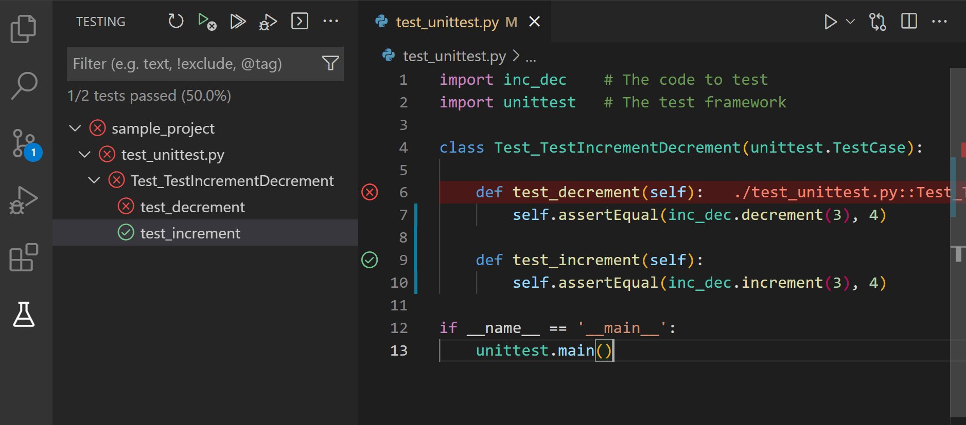
Security Analysis
Dynamic Analysis
Learn about program’s properties by executing it.
Examine the program state throughout/after execution by gathering additional information.
Conventional unit testing on IDEs are dynamic analysis.
Testing Python programs on VS Code

Slide 35
Security Analysis
Static Analysis
Learn about the program’s properties without executing it.
Systematic examination of an abstraction of a program.
1 x = 10;
2 y = x;
3 z = 0;
4 while(y > -1) {
5 x = x/y;
6 y = y-1;
7 Z = 5;
8 }
How would you learn if your program is safe from “divide by 0”?

Slide 36




Security Analysis
Static Analysis
Static analysis can be performed through many mainstream IDEs, such as PyCharm (Python), Eclipse (C/C++), Visual Studio (for VB) , etc.
Some dedicated static analysis tools for Python: Pylint, MyPy, etc.
There are some off-the-shelf static analysis toolkits dedicated to static analysis of Android apps. SootUp (formerly known as Soot) is the widest adopted one in the research community.

Slide 37
Security Analysis
Dynamic Analysis vs Static Analysis
What are the pros and cons of these two types of analysis?
Static Analysis
Benefits
Analyzes all possible executions of the program.
Pinpoint in code where issues occur.
Detects issues in the early stages of development.
Limitations
Rice’s Theorem: Every static analysis is necessarily incomplete, unsound, or undecidable.
Difficult to track runtime properties.
May analyze parts of the program that are never executed (unreachable code).
Dynamic Analysis
Benefits
Analyses the state of the program in a runtime environment.
If the property we are looking for is found, we can be sure that it exists.
Validate static analysis findings.
Limitations
Input dependent
Cannot explore all paths

Slide 38
Security Analysis
Taint Analysis
Information flow analysis.
(Mainly) used in the security domain.
Tracking how private/sensitive information flows through the program and if it is leaked to public observers.
static taint analysis at the beginning, dynamic taint analysis introduced in recent years
Sources
Private/sensitive data of interest
Sinks
Locations of interest
Check taints of incoming information
Determines if there is a leak in the program.

Slide 39
Security Analysis
Taint Analysis
1 input = get_input();
2 tmp = “select …” + input;
3 query(tmp);
4 log(tmp);
1 input = Source();
2 tmp = “select …” + input;
3 query(tmp);
4 Sink(tmp);
input
priv
SOURCE
tmp
SINK
Warning!
Taint is removed from the value after proper sanitization
1 input = get_input();
2 tmp = “select …” + input;
3 tmp = hash(tmp);
4 query(tmp);
5 log(tmp);
1 input = Source();
2 tmp = “select …” + input;
3 tmp = hash(tmp);
3 query(tmp);
4 Sink(tmp);
input
priv
SOURCE
tmp
sanitized
SINK
PASS

Slide 40


Security Analysis
Taint Analysis
Taint analysis for mainstream programming languages can be done by static analysis toolkits.
There are some mature taint analysis frameworks for complex systems (such as Android apps) off-the-shelf, such as Mariana-Trench proposed by Facebook, appshark proposed by ByteDance.

Slide 41
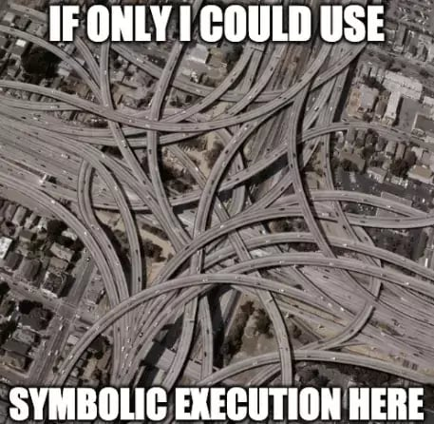
Security Analysis
Symbolic Execution
Symbolic execution (aka. symexe) is a software testing technique that substitutes the normal inputs into a program (e.g. numbers) through symbolic values (formulae) during the program execution.
When program execution branches based on a symbolic value, the system follows both branches (paths) and maintains a path condition for each.

Slide 42
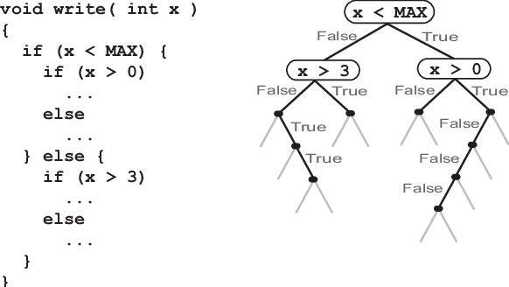
Security Analysis
Symbolic Execution
Benefits:
Symbolic execution generates exactly one test case per execution path through the code, minimizing redundant test cases.
It is a mathematically precise approach, so using it results in a test suite that aims to explore all possible program outcomes.
Biggest limitation:
Symbolically executing all feasible program paths does not scale to large programs. It is path-by-path, vs. dynamic testing is input-by-input.

Slide 43


Security Analysis
Symbolic Execution: Off-the-Shelf Tools
KLEE is an open-source dynamic symbolic execution engine built on top of the LLVM compiler infrastructure. It is named after Paul Klee, a Swiss-born German artist, and maintained by a research team at the Imperial College.
Almost all other symbolic execution tools are built based on KLEE for Java, Javascript, Android Dalvik, etc.
Symbolic execution is still an open research topic.
The role of art is not to reproduce visible objects, but to make invisibles visible.

Slide 44

Leveraging taint analysis for privacy preservation assessment
Case Study: A large-scale privacy assessment for Android third-party SDKs
We can maintain a pool of API methods that can be used by third-party SDKs/apps to read privacy-sensitive data, e.g., getImei(), getLocation(), getSerial(), etc.
We define a list of dangerous methods that can share something sensitive to the public, such as the Internet, public storage of the device (i.e., /sdcard/), and system settings.
Note that we are studying privacy preservation, that a piece of privacy data after hashing could still uniquely identify a user or a device, so we set no sanitization roles.
Then we use an off-the-shelf static taint analysis tool to analysis different SDKs, and flag a privacy leakage incident if we can find a tainted data flow.
M. H. Meng, C. Yan, Y. Hao, Q. Zhang, Z. Wang, K. Wang, S. G. Teo, G. Bai, and J. S. Dong, “A large-scale privacy assessment of android third-party sdks,” arXiv preprint arXiv:2409.10411, 2024.

Slide 45
Leveraging taint analysis for privacy preservation assessment
Case Study: A large-scale privacy assessment for Android third-party SDKs
We can maintain a pool of API methods that can be used by third-party SDKs/apps to read privacy-sensitive data, e.g., getImei(), getLocation(), getSerial(), etc.
We define a list of dangerous methods that can share something sensitive to the public, such as the Internet, public storage of the device (i.e., /sdcard/), and system settings.
Note that we are studying privacy preservation, that a piece of privacy data after hashing could still uniquely identify a user or a device, so we set no sanitization roles.
Then we use an off-the-shelf static taint analysis tool to analysis different SDKs, and flag a privacy leakage incident if we can find a tainted data flow.
Our static taint analysis identified 2318 instances of privacy data access (traces initialized from the source) across 27 of the 41 pre-identified data types from 158 SDKs.
The analysis revealed that 346 (14.9%) of these accesses were tainted, suggesting potential leakage of privacy data into public spaces.
M. H. Meng, C. Yan, Y. Hao, Q. Zhang, Z. Wang, K. Wang, S. G. Teo, G. Bai, and J. S. Dong, “A large-scale privacy assessment of android third-party sdks,” arXiv preprint arXiv:2409.10411, 2024.

Slide 46
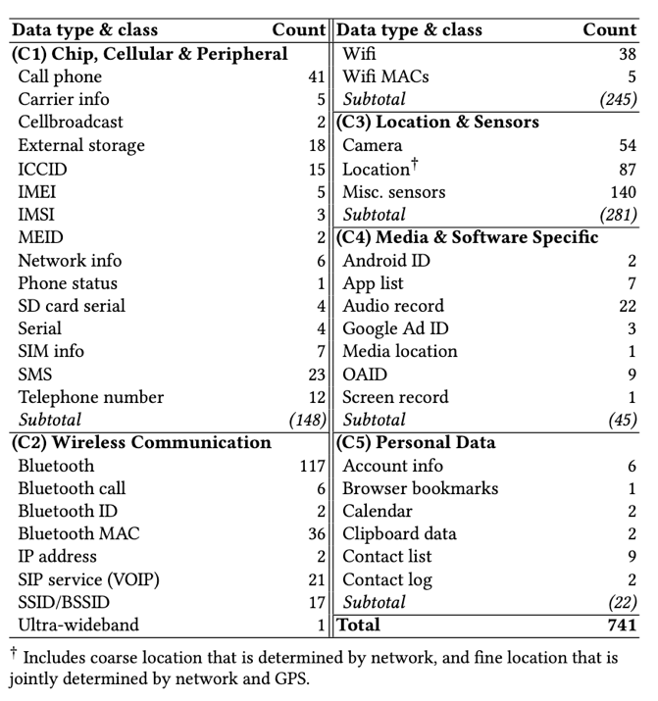
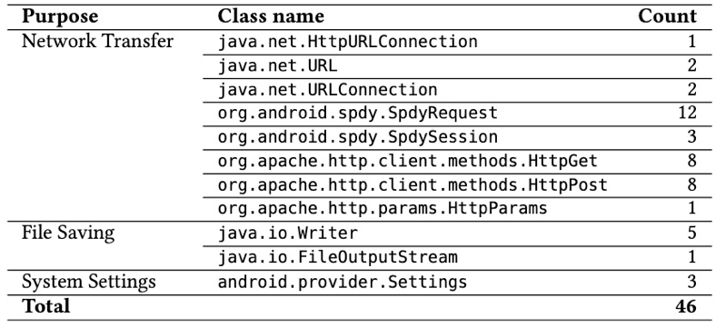
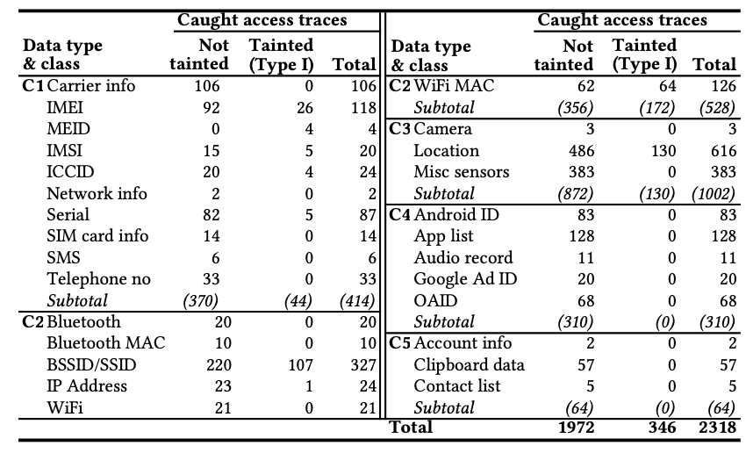
Leveraging taint analysis for privacy preservation assessment
Case Study: A large-scale privacy assessment for Android third-party SDKs
(b)
(a)
(c)
(a) Statistics of source methods per privacy data type
(b) List of sink methods
(c) Results of tainted access traces per privacy data type

Slide 47
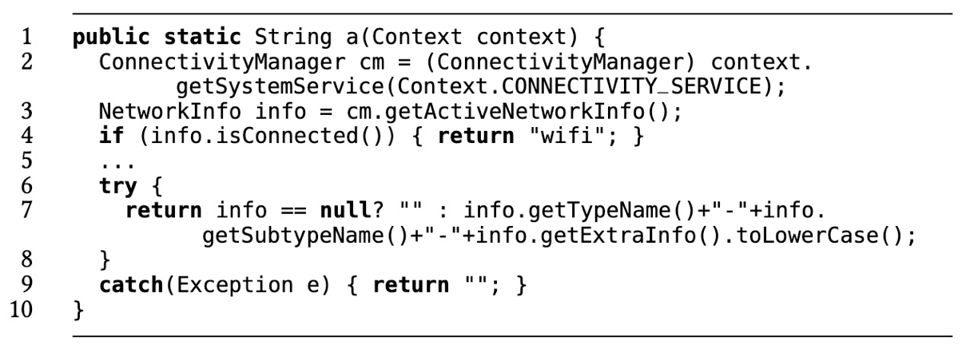
Leveraging taint analysis for privacy preservation assessment
Case Study: A large-scale privacy assessment for Android third-party SDKs
A real-world example of a false positive
Manual efforts are necessary to exclude false positives from the findings.
An example code reverse-engineered from one of our examined SDKs named “mipush”. We find it attempts to read the SSID of the connected WiFi but is later assessed by us as a false alarm.
The SSID reading action (can be realized by the method getExtraInfo (line 7) until Android 10) would only take place if the device is not connecting to WiFi (after line 4), therefore we determine this is a logically infeasible code regarding privacy
data access.

Slide 48
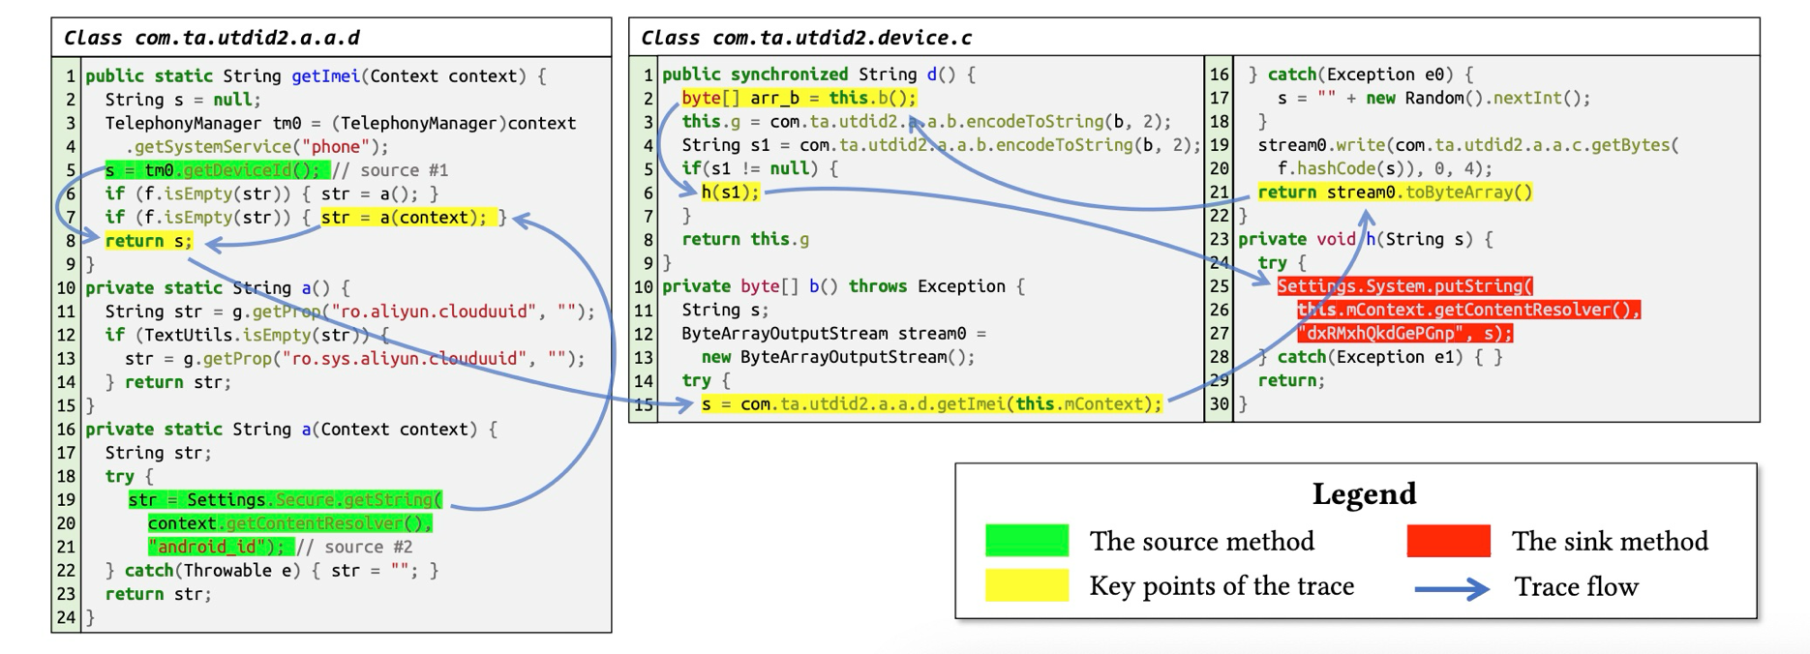
Leveraging taint analysis for privacy preservation assessment
Case Study: A large-scale privacy assessment for Android third-party SDKs
A real-world example of a tainted trace
Information flow demonstrates how the device ID is accessed and saved to the system settings by one of our analyzed SDKs (the obfuscated code is obtained from reverse engineering and has been simplified to save space)

Slide 49
Fuzzing & Penetration Testing
Fuzzing · Penetration Testing

Slide 50
Fuzzing & Penetration Testing
Fuzzing
A kind of random testing
Goal: make sure certain bad things don’t happen, including:
Crashes,
Thrown exceptions,
Non-termination.
All of these things can be the foundation of security vulnerabilities
Fuzzing complements functional testing
Fuzzing tests features directly (i.e., unit testing)
Normal test cases can be starting points for fuzz tests

Slide 51
Fuzzing & Penetration Testing
Fuzzing
Black box
The tool knows nothing about the program or its input.
Easy to use and get started, but will explore only shallow states unless it gets lucky.
White box
The tool generates new inputs at least partially informed by the code of the program being fuzzed.
Often easy to use, but computationally expensive.
Grey box
Only partial information is available but not the (complete) source code.
Both black box testing and white box testing are utilized.
Balance of performance and coverage/completeness.

Slide 52
Fuzzing & Penetration Testing
Penetration Testing
Penetration testing (aka. pen test) assesses security by actively trying to find exploitable vulnerabilities!
Pen testers employ ingenuity (or reconnaissance) and automated tools to rapidly explore a system’s attack surface, looking for weaknesses to exploit
Common tools for pen test
Nmap for network scanning
Zap web proxy for probing, exploitation
Metasploit for general-purpose exploitation
Fuzzing is a useful technique for pen test
Find improperly handled inputs
Exploitation discovery usually begins with failure inputs

Slide 53

Fuzzing & Penetration Testing
Penetration Testing: A Case Study of Web Hacking
Pen tester analyzes the system as a White Hat.
Suppose there is an online shopping website with a sample use case provided by the website owner: http://tgt.com/bug?item=1&price=5.00
http://tgt.com/bug?item=1&price=0.01
Untrusted parameters?
http://tgt.com/bug?item=100&price=5.00
Susceptible to XSS?
http://tgt.com/bug?item=1&price=5.00<script>alert(document.cookie);</script>
http://tgt.com/bug?item=1&price=5.00&currency=VND
Other parameter injection?
70% messing with parameters, 10% default passwords, 10% hidden files and directories, and 10% other problems (bad authentication, wrong configuration, etc.)
-- Statistics cited from training materials of the University of Maryland, College Park

Slide 54

Time to wrap up
What we have covered today:
Low-level memory-based security – Where the story begins
Web security – Where does the low-level security evolve to
Security analysis – Foundations of software engineering security
Fuzzing and penetration testing – How can software security be applied
Cybersecurity/Computer Security is an independent subject in the broad sense of IT and demands interdisciplinary knowledge, theories, and techniques from computing theory, software engineering, mathematics & natural sciences, laws, social sciences, and even humanity.
You are encouraged to discover more on this topic off the campus!

